Slide 1
DATA WAREHOUSE ASSIGNMENT 2
ADNAN SAMAD
ALISHA HAMEED
AIZA KHAN
MUHAMMAD OMER SIDDIQUI
TAHA SHARIF

Slide 2
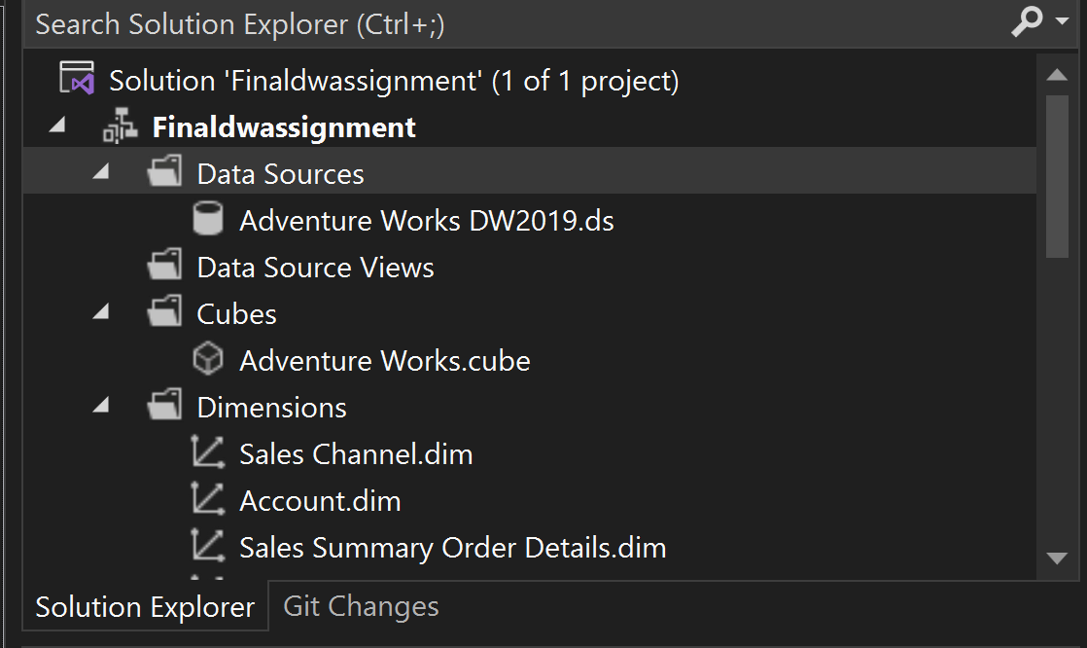
DATA CUBE

Slide 3
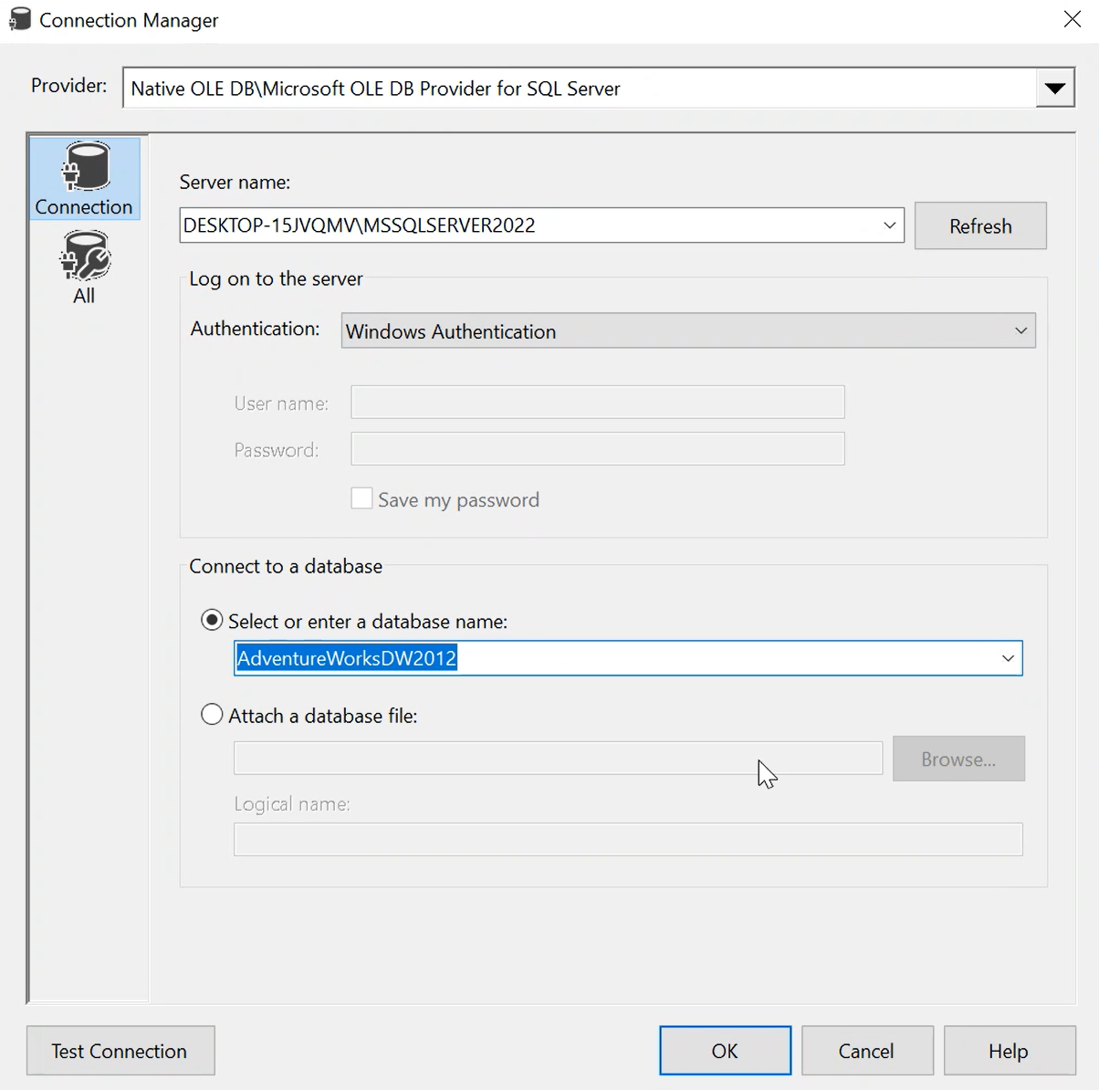

Slide 4
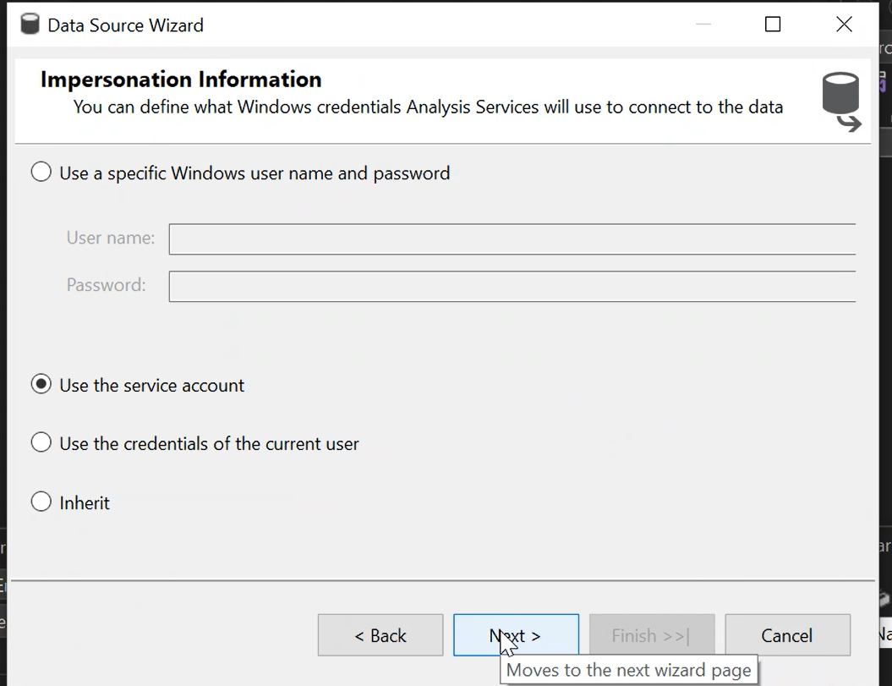

Slide 5
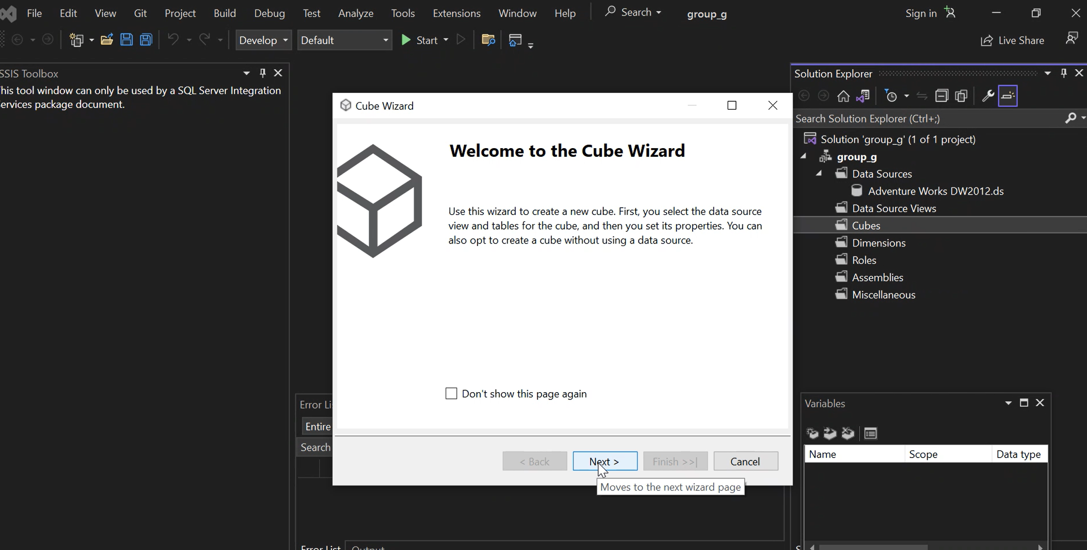

Slide 6
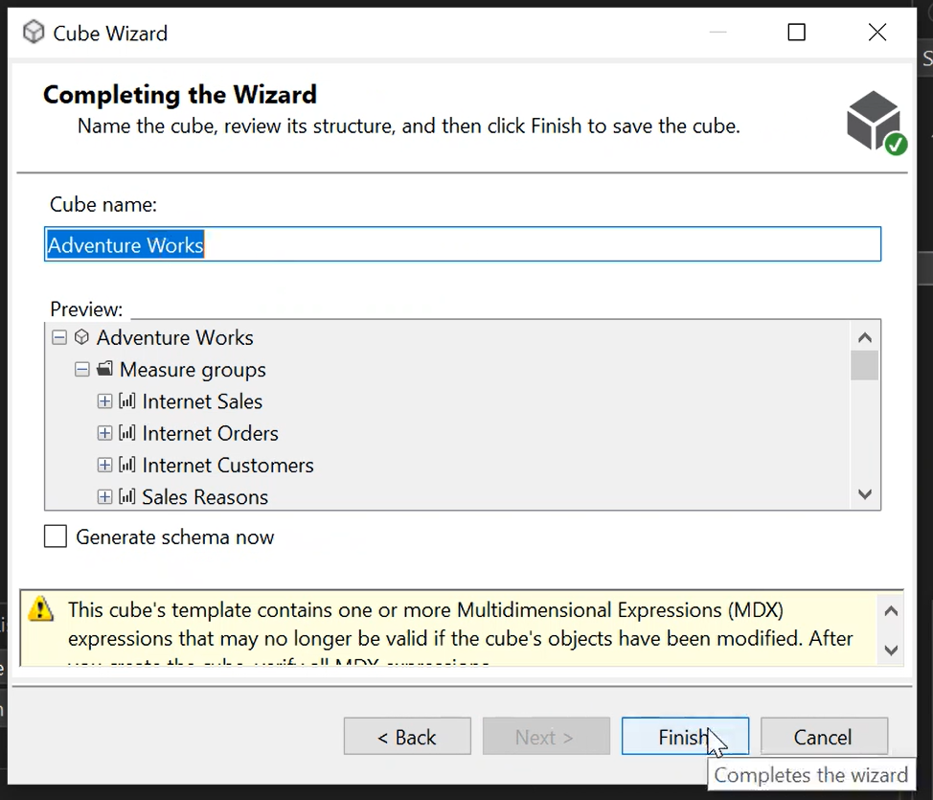

Slide 7
Scenario: Creating a Data Warehouse with AdventureWorks
In this scenario, we are creating a data warehouse using the AdventureWorks database. AdventureWorks is a sample database provided by Microsoft that simulates an e-commerce system. The goal of the data warehouse is to consolidate and integrate data from multiple sources within the AdventureWorks database, enabling efficient reporting, analysis, and decision-making.

Slide 8
Definition of a Data Warehouse: A data warehouse is a central repository that stores structured, historical data from various sources. It is designed to support business intelligence and reporting activities by providing a consolidated and consistent view of data for analysis and decision-making purposes. Data warehouses typically involve the extraction, transformation, and loading (ETL) of data from source systems into a dimensional model that optimizes querying and reporting performance.

Slide 9
Explanation of the Scenario: In this scenario, we are using the AdventureWorks database as the source for our data warehouse. AdventureWorks contains tables representing different aspects of an e-commerce system, such as customers, orders, products, and sales. Our goal is to create a data warehouse that consolidates and integrates these tables to provide a unified view of the data.

Slide 10
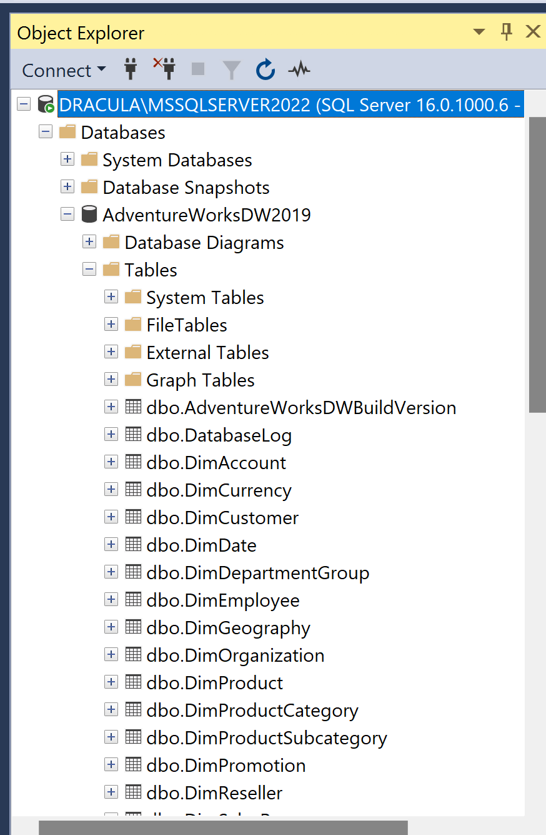
Adventure Works DW

Slide 11
By creating a data warehouse with AdventureWorks, we are able to consolidate and integrate data from various tables within the database, providing a solid foundation for reporting and analysis. The dimensional model and optimized structure of the data warehouse allow for efficient querying and reporting, empowering business users to gain valuable insights and make informed decisions based on the data.

Slide 12
THANK YOU

